Slide 1
World Life Expectancy Statistical Analysis
Roshan

Slide 2
What are the contributing factors to life expectancy worldwide?
And how to interpret it.

Slide 3

The Raw Data from WHO
and
statvision.com
www.statvision.com

Slide 4
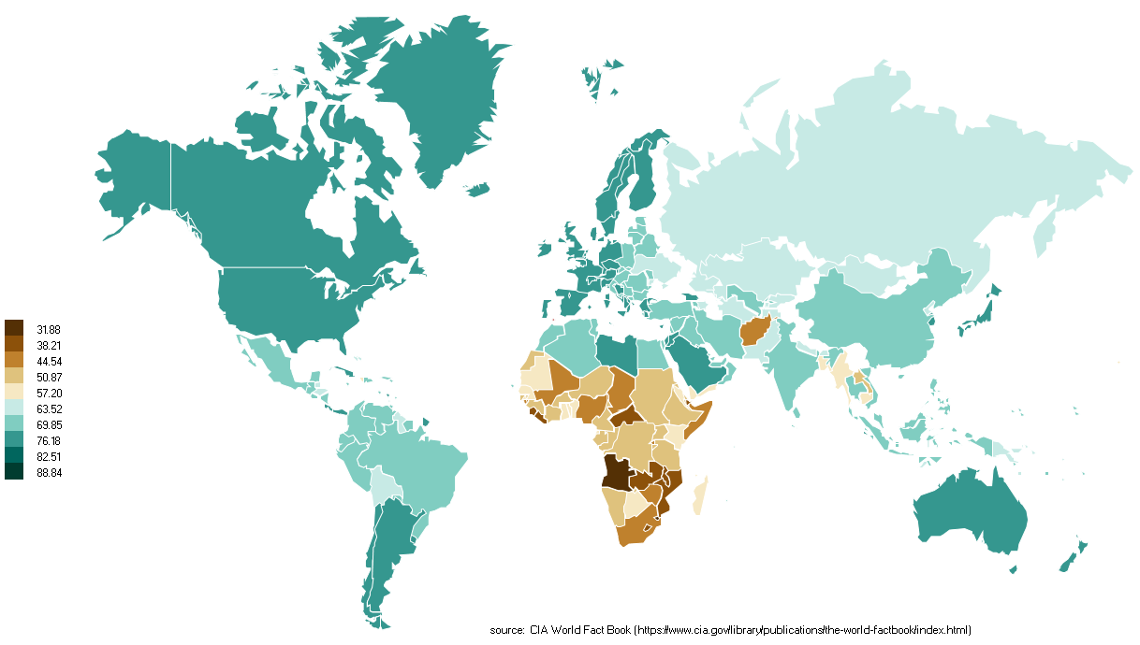
Life expectancy at birth (2009)

Slide 5
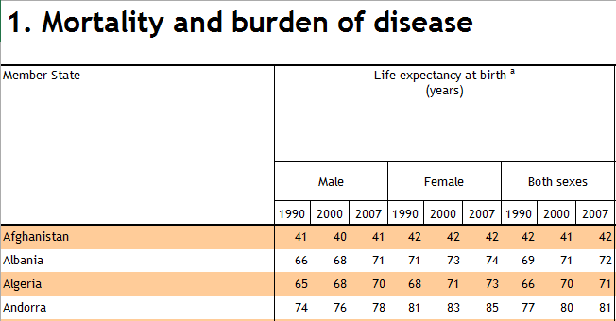
Structure of WHO Raw Data
193 States, Nine Sections, Year 1997, 2000, 2007 (selected), Male, Female, Both (selected):
Mortality and burden of disease
Selected Life expectancy at birth (years) as dependent variable
Selected the following as independent variables:
Infant mortality rate (probability of dying between birth and age 1 per 1000 live births)
Under-5 mortality rate (probability of dying by age 5 per 1000 live births)
Adult mortality rate probability of dying between 15 to 60 years per 1000 population)
Cause-specific mortality and morbidity (ignored)
Selected infectious diseases (ignored)
Health service coverage (ignored)

Slide 6
Structure of WHO Raw Data (Cont’d)
Risk factors
Access to improved drinking-water source (%)
Access to improved sanitation (%)
Alcohol consumption among adults aged ≥ 15 years (litres per person per year)
Prevalence of current tobacco use (%) Adults (≥ 15 years)
Prevalence of current tobacco use (%) Adolescents (13-15 years)
Health workforce, infrastructure, essential medicines
Physicians Density (per 10 000 population)
Nursing and midwifery personnel Density (per 10 000 population)
Hospital beds (per 10 000 population)

Slide 7
Structure of WHO Raw Data (Cont’d)
Health expenditure
Total expenditure on health as % of gross domestic product
Per capita total expenditure on health at average exchange rate (US$)
Health inequities (ignored)
Demographic and socioeconomic statistics
Total Population ('000s)
Median age
Under 15 (%)
Over 60 (%)
Annual growth rate (%)
Living in urban areas (%)
Total fertility rate (per woman)
MDG 5 Adolescent fertility rate (per 1000 women)
Adult literacy rate (%)
Gross national income per capita (PPP int. $)

Slide 8
Additional Columns (Independent Variables)
Region
Africa
Asia&Oceanania
Europe
LatinAmerica
MiddleEast
NorthAmerica
Latitude (average) from statvision.com
Longitude (average) from statvision.com

Slide 9
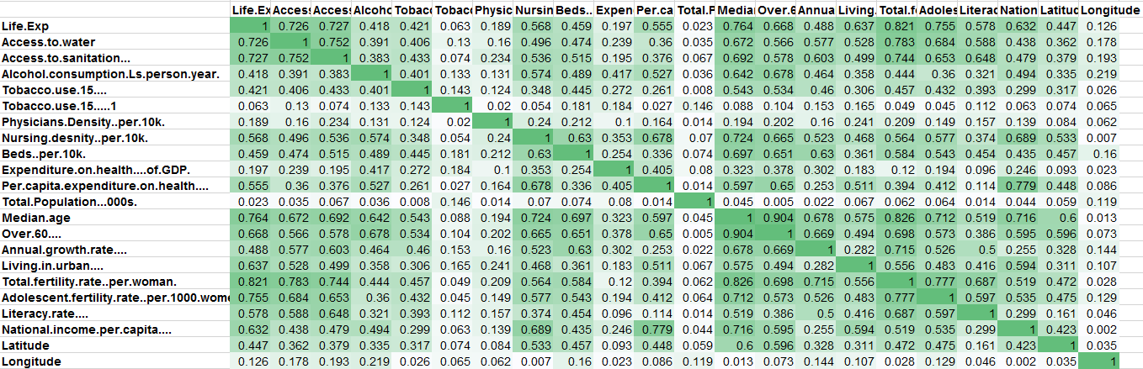
Correlation Table (Absolute value)

Slide 10
Regression
Coefficients
Life expectancy at birth (2009)
Europe 3.0352895
NorthAmerica 0.0570579
MiddleEast 6.5142421
Asia&Oceanania 5.9340752
LatinAmerica 7.2234019
Africa 0 (ref)

Slide 11
Annual Growth Rate
Faster the population grows, the longer you’d live
Estimate Std. Error t value Pr(>|t|)
2.0118984 0.4376528 4.597 8.05e-06 ***

Slide 12
3 Countries with the highest growth rate from our dataset
State | Region | Annual growth rate (%)
United Arab Emirates | Middle East | 4.7
Kuwait | Middle East | 4.4
Qatar | Middle East | 4.2

Slide 13
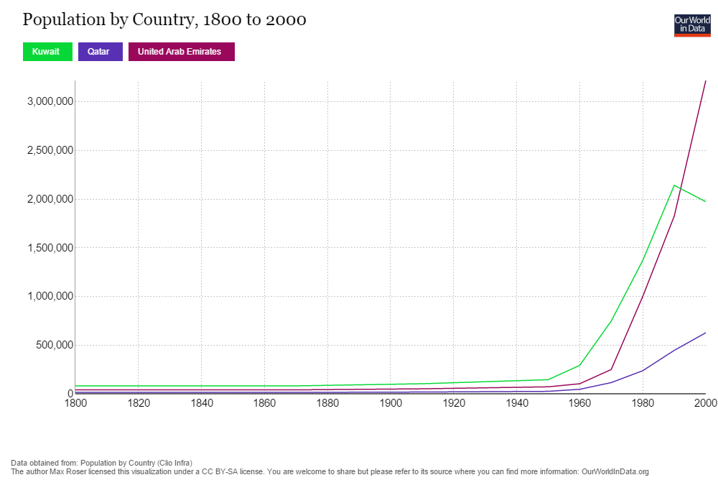
Population growth rate

Slide 14
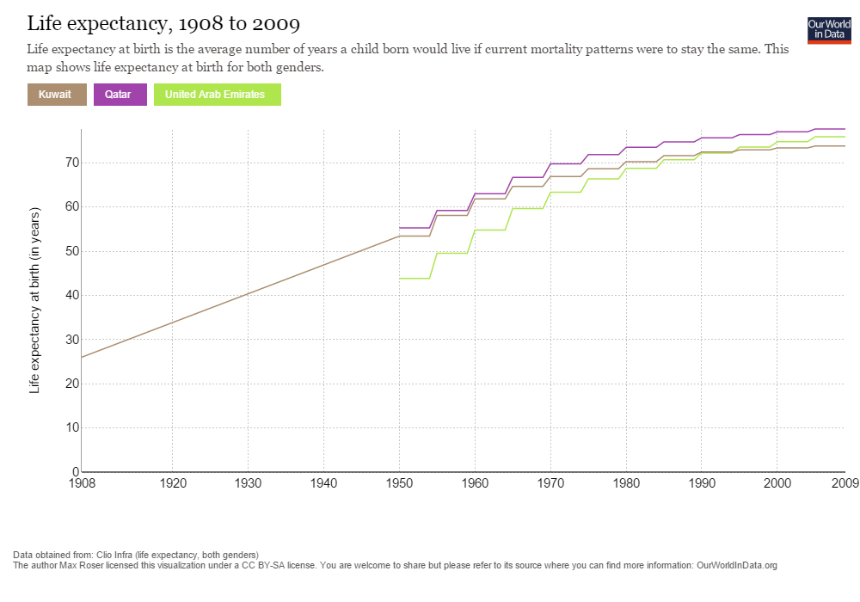
Life Expectancy

Slide 15
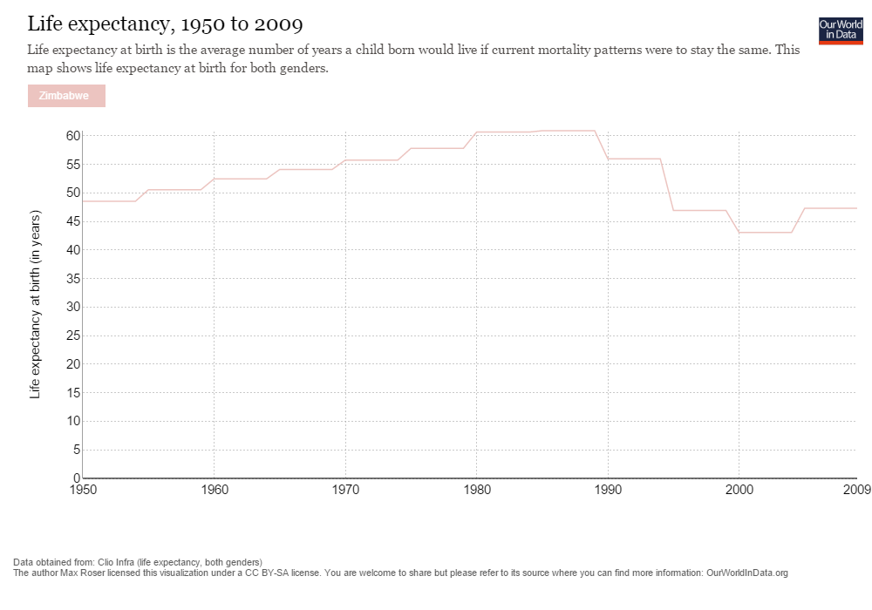
Life Expectancy in Zimbabwe

Slide 16
Statistical proof
Interaction between life expectancy of Middle east and annual growth rate:
RegionMiddleEast:Annual.growth.rate 4.339 1.758 2.469 0.014482 *
ANOVA test:
Model 1: Life.Exp ~ Region + Per.capita.expenditure.on.health.... + Over.60.... + Living.in.urban....
+ Total.fertility.rate..per.woman.
+ Adolescent.fertility.rate..per.1000.women. + Longitude
Model 2: Life.Exp ~ Region + Per.capita.expenditure.on.health.... + Over.60....
+ Annual.growth.rate.... + Living.in.urban.... + Total.fertility.rate..per.woman.
+ Adolescent.fertility.rate..per.1000.women. + Longitude
Res.Df RSS Df Sum of Sq Pr(>Chi)
1 181 3182.9
2 180 2848.5 1 334.42 4.286e-06 ***

Slide 17
Literature proof
Africa & the Middle East: A Continental Overview of Environmental Issues (The World's Environments), Nov 17, 2003, by Kevin Hillstrom and Laurie Collier Hillstrom
In terms of population growth, Africa and Middle East are among the fastest growing regions in the world. In the Middle East, the presence of the World’s largest oil reserves has produced notable standard of living gains in health and education as well as in infrastructure investment.
Middle Eastern have now dramatically upgraded their health services sector in the past half-century. Infant mortality rates in oil rich Persian Gulf states such as Kuwait are now roughly comparable to those in the developed countries.
Life expectancy in the Middle East and North Africa is considerably higher than the regional average of two decades earlier, but these numbers are lower than the average for developed countries and only slightly higher than the average for all developing nations.

Slide 18
Cluster Analysis
Cluster | Life.Exp | Per.capita.expenditure.on.health | Over.60 | Annual.growth.rate | Living.in.urban | Total.fertility.rate..per.woman. | Adolescent.fertility.rate | Longitude
1 | 74.03 | 916.10 | 13.53 | 0.73 | 68.00 | 1.97 | 29.90 | 16.87
2 | 64.09 | 146.09 | 7.79 | 1.63 | 47.65 | 3.42 | 70.50 | 21.48
3 | 80.53 | 3292.79 | 21.21 | 0.86 | 78.95 | 1.65 | 11.68 | 26.90
4 | 80.29 | 5992.29 | 19.71 | 0.66 | 84.57 | 1.80 | 20.14 | -10.49

Slide 19
